Slide 1
Under Water Image Enhancement Techniques and Image Restoration

Slide 2
INTRODUCTION
The oceans contain unknown creatures and vast energy resources, playing an important role in the continuation of life on earth
Since the middle of the 20th century, marine exploration worldwide has actively engaged in high-tech activities
Vision technology has attracted great attention, for its ability to carry high information density
Researchers strive to capture high-quality underwater images for a variety of underwater applications, including robotics
Rescue missions, man-made structures inspection, ecological monitoring, sea organisms tracking and real-time navigation.
However, the quality of underwater images is severely affected by the particular physical and chemical characteristics of underwater conditions, raising issues that are more easily overcome in terrestrial imaging
Underwater images always show color cast, e.g., green bluish color, which is caused by different attenuation ratios of red, green and blue lights

Slide 3
Literature Survey
Underwater image colour constancy based on DSNMF
In 2017, Liu et al. [54] proposed a method called Deep Sparse Non-negative Matrix Factorisation (DSNMF) to estimate the illumination of underwater images. First, the observed images were segmented into small blocks, each channel of the local block was reconstructed into a [R, G, B] matrix, and the depth of each input matrix was decomposed into multiple layers by the sparsity constraint of the DSNMF method. The last layer of the factorization matrix is used as the illumination for the patch, and the image is adjusted with sparse constraints. After factorization, the local block illumination of the original image is estimated to obtain the enhanced image

Slide 4
Color Correction of Underwater Images for Aquatic Robot Inspection
In 2005, Torres-Méndez et al. [55] used Markov Random Field (MRF) to describe the correlation between underwater images before and after distortion, and enhanced the color of images based on the maximum a posteriori. When calculating the dissimilarity of image patches, the image is transformed to CIE-Lab color space to represent equal perceived differences. The experimental data obtained from different underwater scenes verified the feasibility and effectiveness of this method.

Slide 5
Underwater Image Enhancement Using An Integrated Color Model
In 2007, proposed an underwater image enhancement algorithm based on an Integrated Colour Model (ICM). Firstly, the heavily attenuated GB channels in the RGB color model are stretched through the entire range [0, 255]. Then the image is converted to the HSI color model; and the and components are finally stretched with sliding histogram stretching to improve the saturation and brightness of the output image.

Slide 6
Automatic system for improving underwater image contrast and color through recursive adaptive histogram modification
In 2017,put forward Recursive Adaptive Histogram Modification (RAHIM), which can increase the natural performance of image color by modifying saturation and brightness of the image in the HSV color model through Rayleigh distribution and the human visual system and finally the enhanced image is converted to RGB color model.

Slide 7
Previous Methods
underwater optical imaging process and the selective attenuation of light, which is drawn and modified based on the model.
When travelling through water, the red light – having a longer wavelength – is absorbed faster than green and blue wavelengths (which are shorter). That is why underwater images often appear to have green-bluish tones.
reviewed more aspects of underwater optical processing, including underwater image de-scattering, underwater image restoration, underwater image quality assessments, and future trends and challenges in designing and processing underwater images.

Slide 8
unsupervised Colour correction method based on Von Kries hypothesis (VKH) and contrast optimization of selective histogram stretching. UCM can effectively remove blue-greenish cast and improve brightness of low components
underwater image enhancement algorithm based on an Integrated Colour Model (ICM). Firstly, the heavily attenuated GB channels in the RGB color model are stretched through the entire range

Slide 9
Proposed Method
we propose an Unsupervised Color Correction Method (UCM) for underwater image enhancement. UCM is based on color balancing, contrast correction of RGB color model and contrast correction of HSI color model.
Firstly, the color cast is reduced by equalizing the color values.
Secondly, an enhancement to a contrast correction method is applied to increase the Red color by stretching red histogram towards the maximum similarly the Blue color is reduced by stretching the blue histogram towards the minimum.
Thirdly, the Saturation and Intensity components of the HSI color model have been applied for contrast correction to increase the true color using Saturation and to address the illumination problem through Intensity.

Slide 10
Algorithm
: Unsupervised Color Correction Method
Step 1: RGB equalisation
Step 2: Stretching
Step 3: HSVS stretching
Step 4: scene radiance

Slide 11
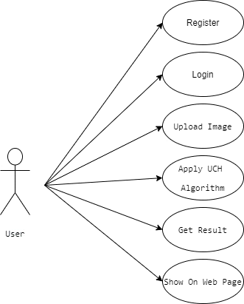
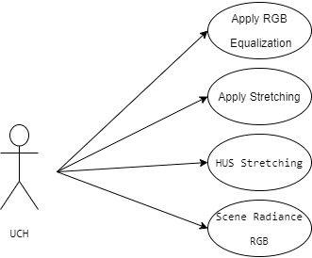
Use Case Diagram

Slide 12
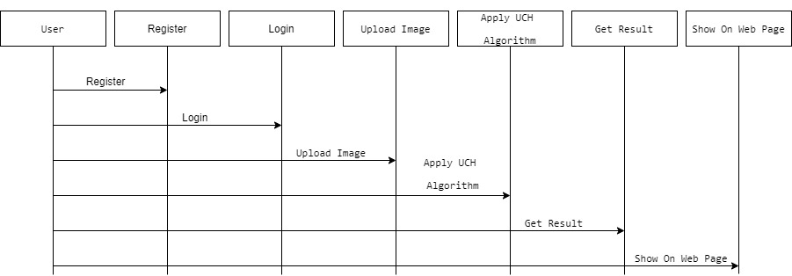
Sequence Diagram

Slide 13
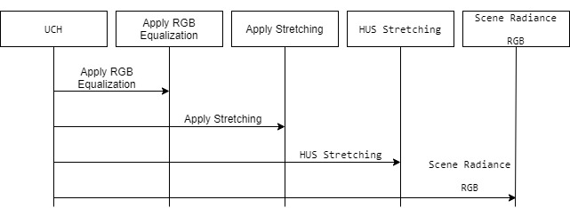

Slide 14
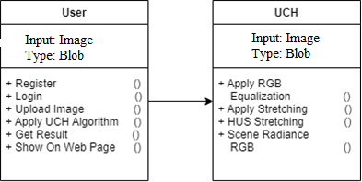
Class Diagram

Slide 15
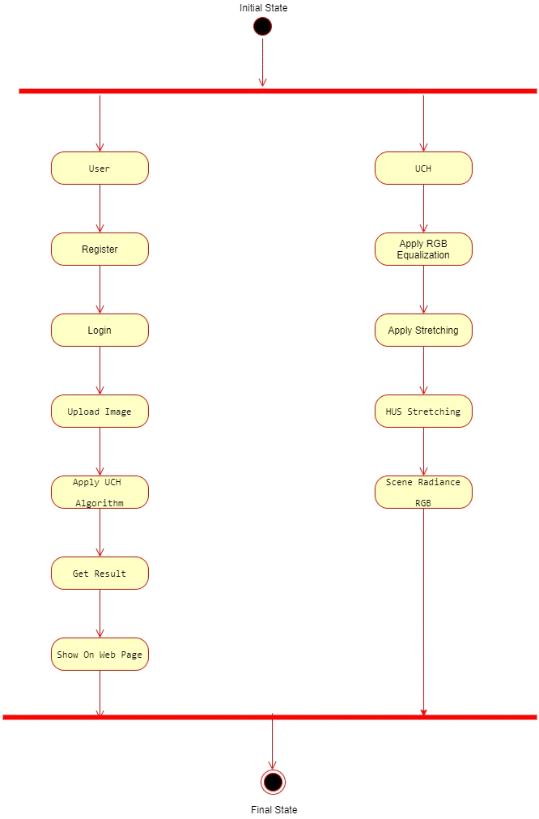
Activity Diagram

Slide 16
Hardware Requirement
System : Intel core i3.
Hard Disk : 500 GB.
Monitor : 15 VGA Color.
Mouse : Logitech.
RAM : 3 GB.

Slide 17
SOFTWARE REQUIREMENTS:
Operating system : Windows XP/7/10
Coding Language : python
Tool : vs code
IDE : Anaconda prompt
Libraries : OpenCV

Slide 18
Datasets
We are using image processing techniques to process input image. We are not using any dataset in this project.
Input: Unwater image
Result: Restored Image, Enhanced Image

Slide 19

Registration Page

Slide 20
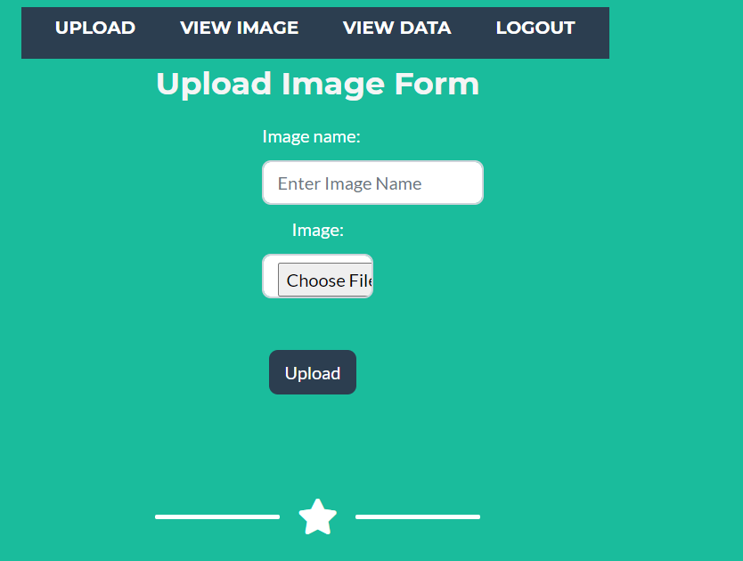
Image Upload Page

